Slide 1
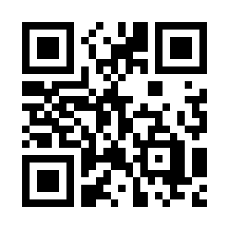
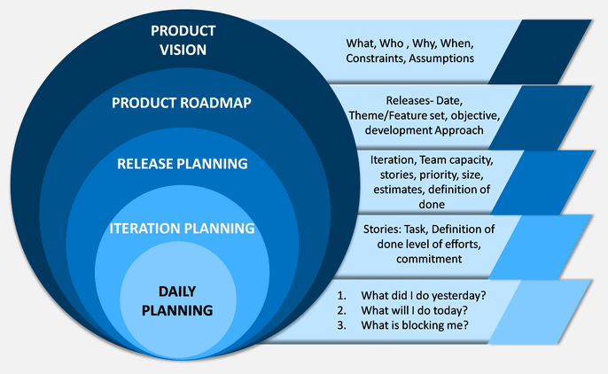
Agile Planning Quiz
https://bit.ly/3S8NJrG

